Slide 1
Network Intrusion Detection using Machine Learning
Project code: B22BH04
Project guide: Dr.Bheemappa Halavar

Slide 2
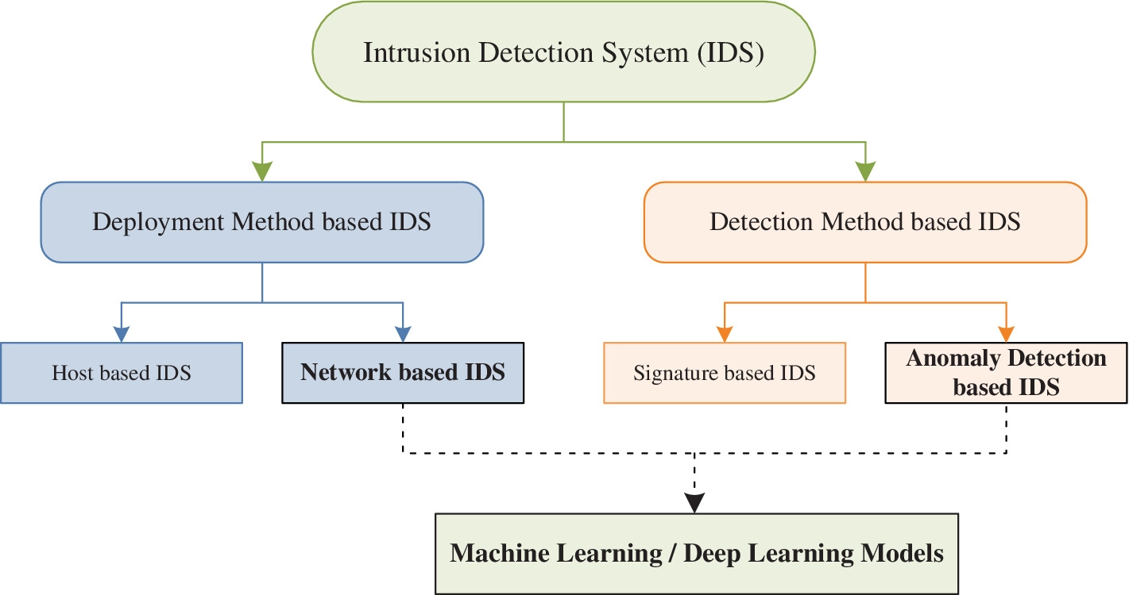
What is an intrusion detection System?
An Intrusion Detection System (IDS) is a monitoring system that detects suspicious activities and generates alerts when they are detected.

Slide 3
Problem statement
Building and comparing Intrusion Detection System implementations using various Machine Learning Models that inspects network traffic and predicts various harmful cyber attacks.

Slide 4
Literature review
PaperNo. | Paper | Year | Methodology | Future Work/ Challenges
1. | Leevy, J. L., & Khoshgoftaar, T. M. A survey and analysis of intrusion detection models based on cse-cic-ids 2018 big data. Journal of Big Data, 7(1), 1-19. | 2020 | This paper analyzes Evaluation metrics of some of the papers which used CIC-IDS dataset. | They analyzed only theoretically without actually analyzing dataset.

Slide 5
Literature review
PaperNo. | Paper | Year | Methodology | Challenges
2. | Farhan, R. I., Maolood, A. T., & Hassan, N. Performance analysis of flow-based attacks detection on CSE-CIC-IDS 2018 dataset using deep learning. Indones. J. Electr. Eng. Comput. Sci, 20(3), 1413-1418. | 2020 | This paper proposes a method which is to use deep neural networks to detect various attack labels. | The proposed model gives an accuracy of 90.25% but claims better cleaning and usage of the dataset.

Slide 6
Literature review
PaperNo. | Paper | Year | Methodology | Results
3. | Kanimozhi, V., & Jacob, T. P. . Artificial intelligence based network intrusion detection with hyper-parameter optimization tuning on the realistic cyber dataset CSE-CIC-IDS 2018 using cloud computing. In 2019 international conference on communication and signal processing (ICCSP) (pp. 0033-0036). IEEE. | 2019 | The proposed approach is to use Artificial Neural Networks algorithm to detect botnet attacks. | With the proposed method, the final accuracy obtained is 99.97 % and a better attack detection rate than the other existing approaches for different attack categories. As it only detects botnet attacks.

Slide 7
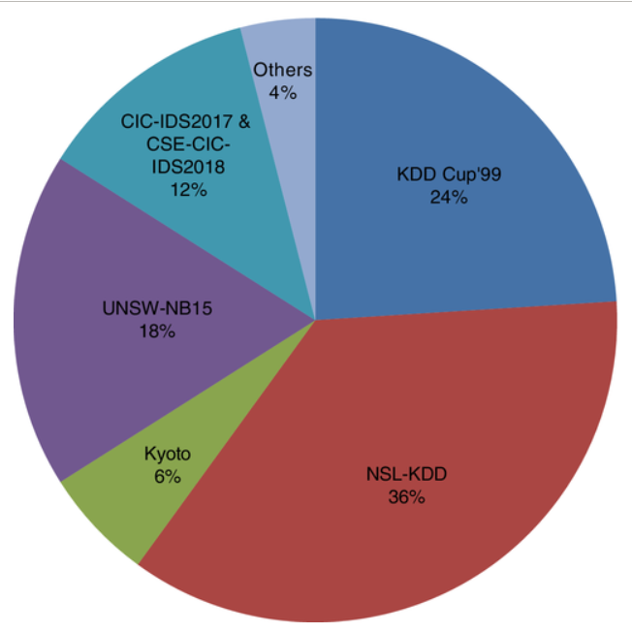
Dataset selection
We have used NSL-KDD Dataset, Which is an iteration of KDD-CUP’99 Dataset.
In comparison to the original KDD data set, the NSL-KDD data set provides the following advantages:
The train set does not contain any redundant records, so the classifiers will not be skewed towards more frequent records.
There are no duplicate records in the suggested test sets, thus the learners' performance is not influenced by approaches with higher detection rates on frequent records.

Slide 8
Dataset selection
NSL-KDD dataset consists of total 1,48,517 x 43 rows and columns.
We have then split the dataset into 70 : 30 ratio. After which we have got the train and test datasets as:
1,03,961 x 43
44,556 x 43

Slide 9
attacks
Dos & DDos
A Denial-of-Service (DoS) attack is an attack meant to shut down a machine or network, making it inaccessible to its intended users.
In Dos attack single system targets the victims system. In Distributed Denial of Service ( DDoS ) multiple system attacks the victims system.

Slide 10
attacks
Probing
Probes are attacks which are purposefully designed so that their targets detect and report such attacks in a recognizable way as well as with a signature that can be tracked. The attacker then uses the collective infrastructure to see where the target is located and its defensive capabilities.

Slide 11
Attacks
R2L
Remote to user (R2L) is one type of computer network attacks, in which an intruder sends set of packets to another computer or server over a network where he/she does not have permission to access as a local user.
U2R
User to root attacks (U2R): Initially attacker access normal user account, later gain access to the root by exploiting the vulnerabilities of the system.

Slide 12
DATA PREPROCESSING

Slide 13
DATA PREPROCESSING
We have mapped the corresponding labels to the unique attack classes.
Dos
Probe
R2L
U2R

Slide 14
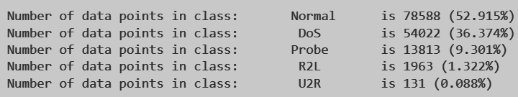
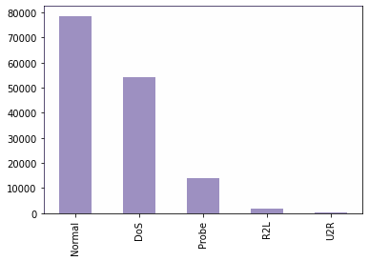
OVER SaMPLINg
The dataset is imbalanced.
The labels are not in correct proportions.
Normal Class is 52% and U2R class is 0.08% which is very bad for the classifier.

Slide 15
FEATURE SELECTION
We have obtained Correlation matrix for the features.
We have found out that 11 features are highly correlated with other features. ( Threshold value : 0.7 ).
So, we have dropped them from the data.
Notes:
A correlation matrix is simply a table which displays the correlation coefficients for different variables. The matrix depicts the correlation between all the possible pairs of values in a table. It is a powerful tool to summarize a large dataset and to identify and visualize patterns in the given data.

Slide 16
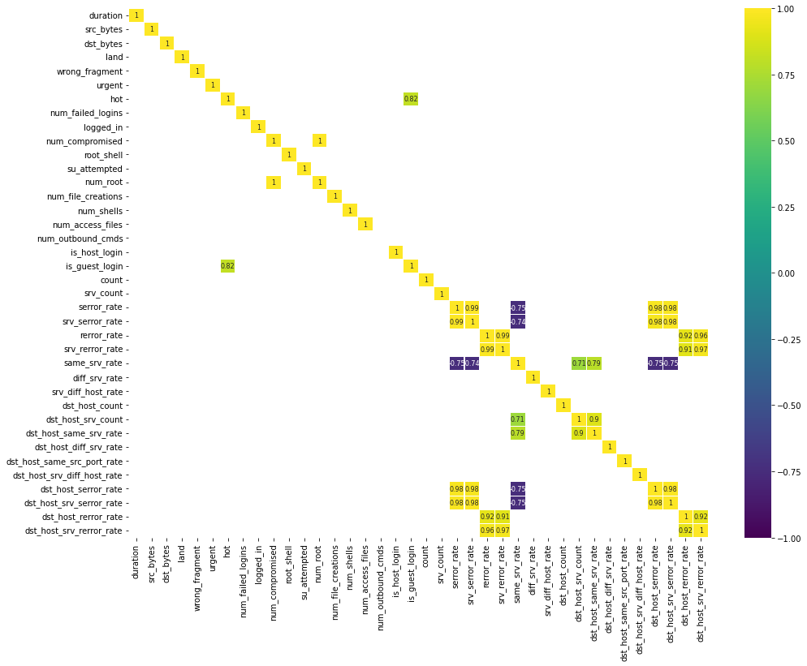
FEATURE SELECTION
Notes:
What is correlation matrix and how it helps our project

Slide 17
Encoding
From both the train and test datasets, we have removed the unnecessary features which doesn’t majorly affect the classification.
Categorical features in the NSL-KDD dataset
Service
Protocol
Flag
Before training, testing the models these categorical data were transformed into integer types using the Ordinal Encoding technique.

Slide 18
The most commonly used machine learning techniques in today’s ids
Decision Trees
Random Forest algorithm
KNN algorithm
Naive Bayes algorithm
Ensembling
Deep Learning algorithms

Slide 19
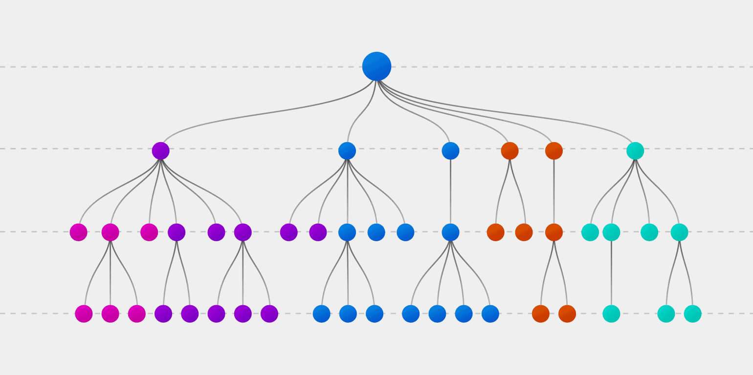
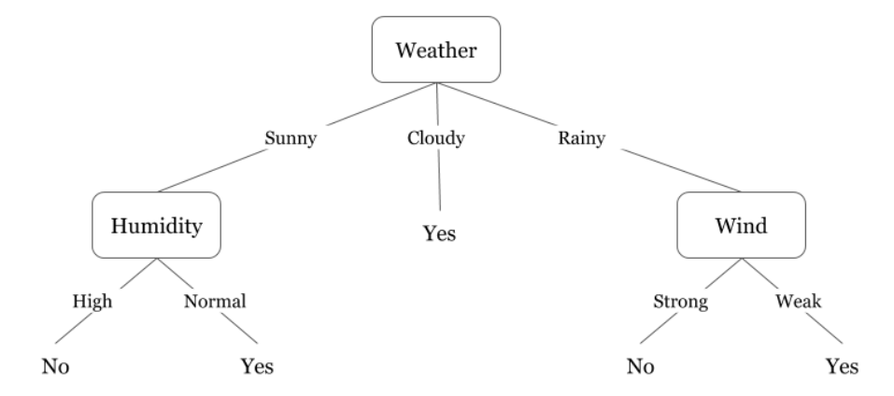
Decision trees

Slide 20

Random forest

Slide 21
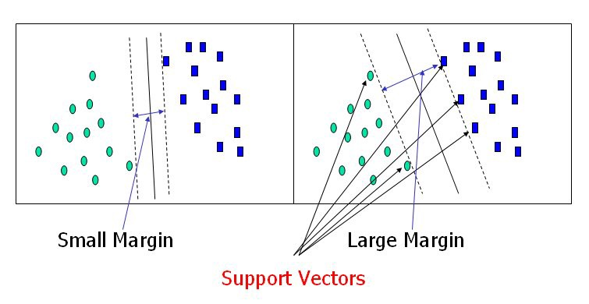
Support vector machine

Slide 22
Drawbacks and advantages observed by us
KNN
KNN algorithm is not good for such a large dataset.
Finding a correct k value is also a very hard task.
Naive Bayes
The assumption that all features are independent is not usually the case in real life.
So, it got high bias.
Decision Trees
They perform good with large volumes of datasets
They are able to handle both numerical and categorical data.
Decision trees provide a clear understanding of which variables are most important for classification.
Although It performs well there might be some overfitting.
Notes:
Due to these drawbacks we chose ensemble learning (results slide)

Slide 23
Ensemble learning
We have incorporated ensemble learning to increase model accuracy
Notes:
Ensemble learning is based on the hypothesis that combining multiple models together can often produce a much more powerful model.
Ensemble learning methods, that often trust the top rankings of many machine learning competitions, are based on the hypothesis that combining multiple models together can often produce a much more powerful model.

Slide 24
ensembling
There are various types of ensemble techniques such as
Bagging algorithm
Boosting algorithm
Notes:
Performance: An ensemble can make better predictions and achieve better performance than any single contributing model.
Robustness: An ensemble reduces the spread or dispersion of the predictions and model performance.

Slide 25
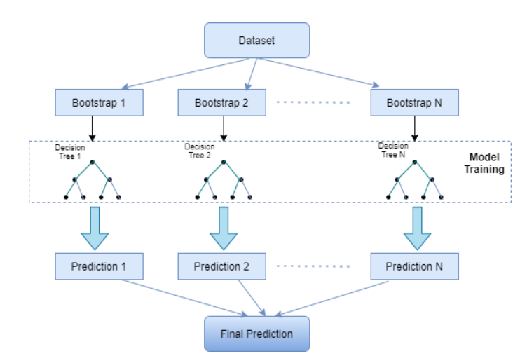
Bagging
Notes:
Why we have chosen bagging?

Slide 26
bagging
We used Bagging technique with base estimator as
Decision Tree Classifier
KNN Classifier
Naive Bayes Classifier

Slide 27
RESULTS - NSL KDD
Classifier | Validation Score | Accuracy | Bagging
Decision Tree Classifier | 99.6 | 98.8 | 99.1
KNN Classifier | 99.3 | 98.9 | 98.9
Naive Bayes Classifier | 72.2 | 72.2 | 98.3

Slide 28
OBSERVATION
Bagging is a completely data-specific algorithm.
The bagging technique reduces model over-fitting. It also performs well on high-dimensional data.

Slide 29
Dataset selection
We have used CSE-CIC-IDS 2018 Dataset for our analysis.
The most recent big data, openly accessible intrusion detection dataset that covers a variety of attacking methods is the CIC-IDS 2018 dataset.
50 terminals made up the attacking infrastructure, and 30 servers and 420 computers were present in the compromised businesses.
This dataset contained the AWS network and machine log files' collected traffic with 80 features that were extracted using CIC FlowMeter-V3.

Slide 30
Dataset preprocessing
Every day, the dataset has been organised. Raw data was recorded for each day, including each machine's event logs for Windows and Ubuntu and network traffic (Pcaps).
Hence, the dataset is heavily imbalanced and not usable for analysis.
So, we looked at the data that was gathered each day, and we selected the labels that contained the different types of attacks from the data obtained on all days.

Slide 31
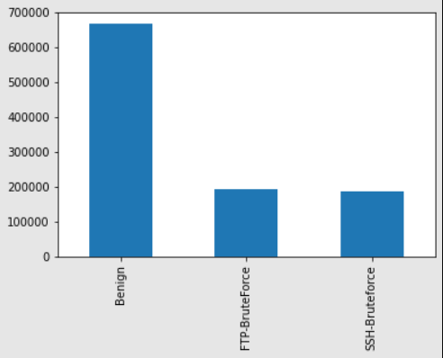
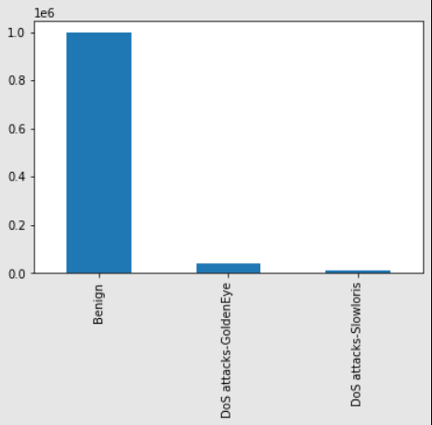
Day 1 Labels
Day 2 Labels

Slide 32
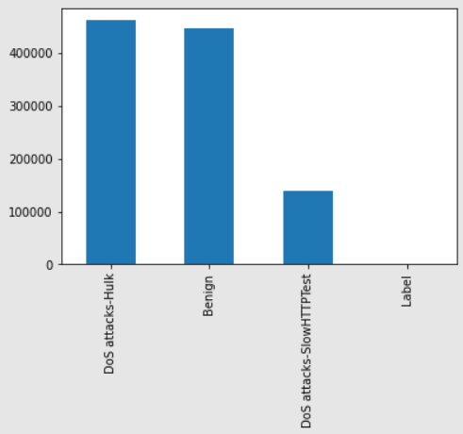
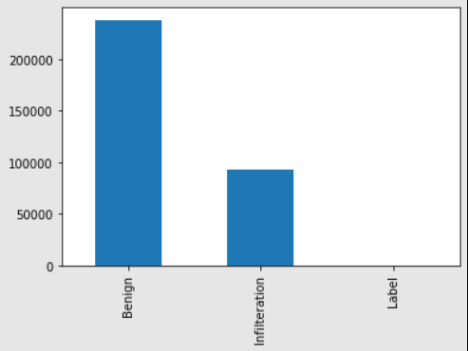
Day 3 Labels
Day 9 Labels

Slide 33
Dataset preprocessing
Since the total number of data points in the dataset is very huge, Undersampling is to be done.
We found out that the least non-negligible number of attacks recorded is 10,990 data points.
Hence, we undersampled all the non-negligible attack labels to the same number.
Therefore, the size of our dataset after preprocessing is (98910x78).

Slide 34
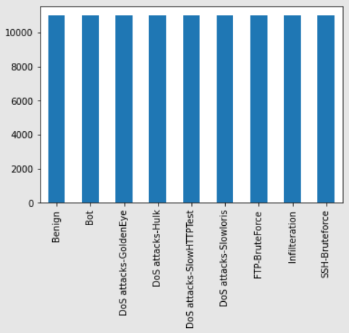
The balanced dataset after performing undersampling contains the following attack labels:
Benign(Normal)
Bot
DoS attacks-GoldenEye
DoS attacks-Hulk
DoS attacks-SlowHTTPTest
FTP-BruteForce
SSH-BruteForce
Infilteration

Slide 35
Feature extraction
We have obtained Correlation matrix for the features.
We have found out that 24 features are highly correlated with other features. ( Threshold value : 0.7 ).
So, we have dropped them from the data.
We then standardized the remaining features using standard scaler.

Slide 36
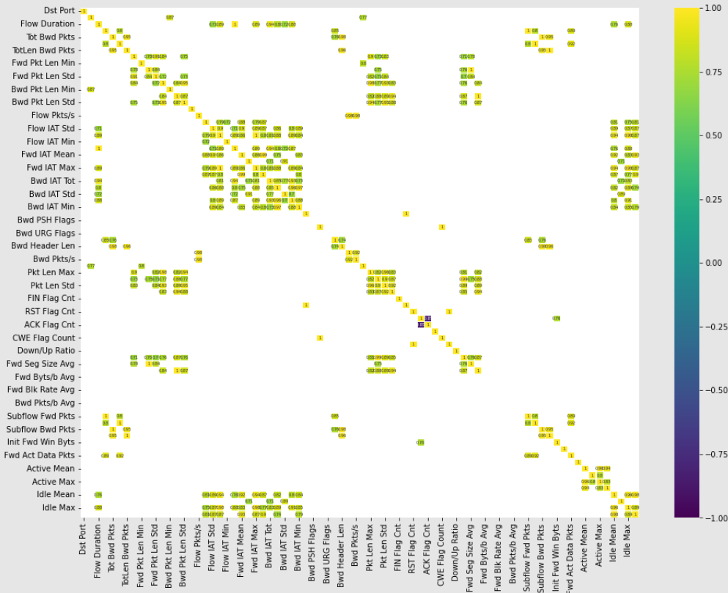

Slide 37
NORMALising
From both the train and test datasets, we have removed the unnecessary features which doesn’t majorly affect the classification.
Then, all the features of the dataset were normalized using Standard Scalar from sklearn.

Slide 38
models
We have used 3 models
Decision Trees
Random Forest
Support Vector Machine

Slide 39
RESULTS - CSE CIC IDS 2018
Classifier | Validation Score | Accuracy
Decision Tree Classifier | 0.8506 | 0.849
SVM Classifier | 0.852 | 0.854
Random Forest | 0.842 | 0.843

Slide 40
Project Roadmap
Literature review and learning about IDS
Ensembling the dataset and using optimizers
Implementation of the model
1
3
5
2
4
6
Finalizing a dataset to build the model
Testing the model and observing the results
Future work

Slide 41
FUTURE WORK
Implementing Deep Learning Techniques to solve the IDS problem and comparing with the existing Machine Learning Models.

Slide 42
references
Ahmad, Zeeshan, et al. "Network intrusion detection system: A systematic study of machine learning and deep learning approaches." Transactions on Emerging Telecommunications Technologies 32.1 (2021): e4150. Link
Kovarasan, Rajesh Kambattan, and Manimegalai Rajkumar. "An effective intrusion detection system using flawless feature selection, outlier detection and classification." Progress in Advanced Computing and Intelligent Engineering. Springer, Singapore, 2019. 203-213. Link
Kanimozhi, V., & Jacob, T. P. (2019, April). Artificial intelligence based network intrusion detection with hyper-parameter optimization tuning on the realistic cyber dataset CSE-CIC-IDS 2018 using cloud computing. In 2019 international conference on communication and signal processing (ICCSP) (pp. 0033-0036). IEEE. Link

Slide 43
references
Farhan, R. I., Maolood, A. T., & Hassan, N. (2020). Performance analysis of flow-based attacks detection on CSE-CIC-IDS 2018 dataset using deep learning. Indones. J. Electr. Eng. Comput. Sci, 20(3), 1413-1418.Link
Seth, S., Chahal, K. K., & Singh, G. (2021). A novel ensemble framework for an intelligent intrusion detection system. IEEE Access, 9, 138451-138467.Link
Leevy, J. L., & Khoshgoftaar, T. M. (2020). A survey and analysis of intrusion detection models based on cse-cic-ids 2018 big data. Journal of Big Data, 7(1), 1-19.Link

Slide 44
Team members details
S. Sai Tarun S20190010157
P. Sree Charan S20190010146
L. Kranthi Kusal S20190010107

Slide 45
Thank you

